Slide 1







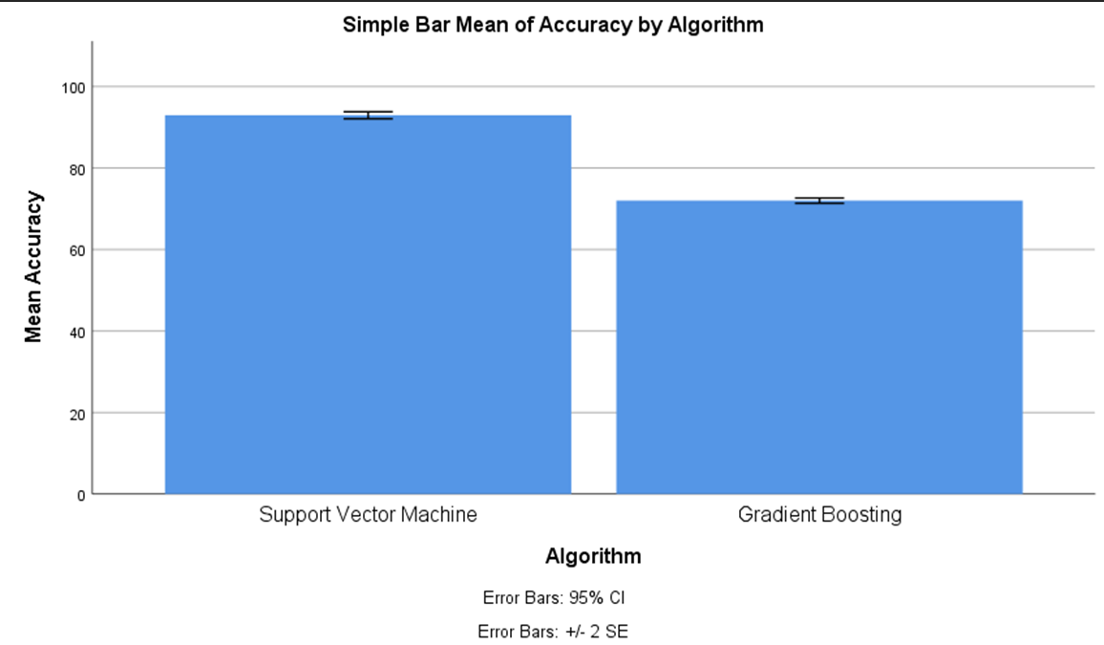
Name: Varun Kumar Register Number: 192110128
Guided by: Dr. J.Joslin Jeya Sheela
Ms. Poorani.S
Guided by Dr. Mary Valantina. G
A Meta Classifier Model for Dispatch Spyware Discernment Using Support Vector Machines (SVM) Comparing With Gradient Boosting Algorithm
INTRODUCTION
The aim is to develop an advanced system capable of effectively discerning spyware during the dispatch process, leveraging state-of-the-art machine learning techniques.
The importance of a Meta Classifier Model for Dispatch Spyware Discernment lies in its ability to enhance detection accuracy, robustness against evolving threats, feature selection, model optimization.
A Meta Classifier Model for Dispatch Spyware Discernment using Support Vector Machines (SVM) and comparing it with the Gradient Boosting Algorithm can have several practical applications in the field of cybersecurity , Spyware Detection in Corporate Networks , Email Security , Web Security.
These are some key features of Support Vector Machines and Gradient Boosting Algorithm in the context of a meta classifier model for discerning spyware are Robustness to Noise , Handling Non-linearity , Handling Imbalanced Data.
The data set contains the Labeling , Data Processing , Serves as the primary dataset for testing and training.
MATERIALS AND METHODS
Pre-processing
Input data
Evaluation and Metrics
Output
Model Validation
Data Analysis and Training
Statistical Analysis values of Mean accuracy (91.93), Standard Deviation(1.335), and Standard error deviation. The Support Vector Machine Algorithm and the GB algorithm have the values of the Mean accuracy, Standard Deviation, and Standard Error.
Comparison of Significance Level with value p<0.05. Both Support Vector Machine Algorithm and the GB Algorithm have a confidence interval of 95% with the significance value 0.000( p<0.05).
RESULTS
Group Statistics
Independent Samples Test
 | Algorithm | N | Mean | std.deviation | Std.error mean
Accuracy | SVM | 15 | 92.93 | 1.668 | .431
 | GB | 15 | 72.00 | 1.254 | .324
 | Levene'sTest |  | T-Test For Equality Of Means
 | F | Sig | t | df | Sig(2-tailed) | Mean difference | Std.Error difference | 95% Confidence
 |  |  |  |  |  |  |  | lower | upper
Equal Variances | 2.550 | .122 | 38.862 | 28 | .000 | 20.933 | .539 | 19.830 | 22.037
No Equal Variances |  |  | 38.862 | 25.993 | .000 | 20.933 | .539 | 19.826 | 22.041
DISCUSSION AND CONCLUSION
According to the study results Support Vector Machine algorithm outperformed XGBoost algorithm with high accuracy of 93.00% .Based on the independent sample t-test, with the total sample size of 450, the significance value p=0.016 (p<0.05) shows that there is significant difference in the algorithms.
The futuring effects of meta-classifier models for dispatch spyware discernment using SVM compared with XGBoost algorithm hold the promise of enhancing cybersecurity measures, reducing false positives, adapting to evolving threats.
Several limitations may be associated with the implementation of a meta-classifier model for dispatch spyware discernment using Support Vector Machines (SVM) compared with the XGBoost algorithm are data Imbalance, Feature Selection Bias, Limited Generalization.
The comparative analysis revealed nuanced performance differences between the two classification approaches. While both SVM and Linear SVC showed promise in accurately identifying dispatch spyware instances.
BIBLIOGRAPHY
Bacci, A.; Bartoli, A.; Martinelli, F.; Medvet, E.; Mercaldo, F.; Visaggio, C. Impact of Code Obfuscation on Android Malware Detection based on Static and Dynamic Analysis; Funchal: Madeira, Portugal, 2018.
Kouliaridis, V.; Kambourakis, G.; Geneiatakis, D.; Potha, N. Two Anatomists Are Better than One—Dual-Level Android Malware Detection.
Yan, P.; Yan, Z. A survey on dynamic mobile malware detection. Softw. Qual. J. 2017.
Odusami, M.; Abayomi-Alli, O.; Misra, S.; Shobayo, O.; Damasevicius, R.; Maskeliunas, R. Android Malware Detection: A Survey. In Communications in Computer and Information Science; Springer International Publishing: New York, NY, USA, 2018.
Soni, Devang, Dev Shah, Shiv Ramolia, Harshil Joshi, and Shivangi Mehta. 2024. “A Novel Approach for PE Malware Detection Using Random Forest Algorithm and Prevention.”

